Slide 1
Tweets Classification for Disaster Management using LSTM AND ANN
BHANU CHANDU RAVIPATI 70072988
PAVAN KALYAN RAO YELAMATI 700729168
HARI CHANDANA GADDAMPALLY 700726882

Slide 2
Contents
1. Title
2. Group Member Information
3. Role/Responsibilities and Contribution in project
4. Motivation
5. Objectives
6. Related work
7. Problem Statement
8. Proposed Solution
9. Results/Simulations
10.References

Slide 3
Group Member Information
BHANU CHANDU RAVIPATI 70072988
PAVAN KALYAN RAO YELAMATI 700729168
HARI CHANDANA GADDAMPALLY 700726882

Slide 4
Role/Responsibilities and Contribution in project
Work | Contributed by
Text processing | Pavan & Bhanu
Evaluation Metrics(Accuracy, Precision, recall, F1-score) | Pavan
Code Implementation(Preprocessing, Fit Evaluate, Predict) | Bhanu
Identification of candidate OOV words | Chandana
Statistical Reports | Chandana

Slide 5
Motivation
Twitter give dynamic correspondence channels during mass intermingling and crisis occasions such as quakes, tropical storms. During the abrupt beginning of an emergency circumstance, influenced individuals post helpful data on Twitter that can be utilized for situational mindfulness and other compassionate fiasco reaction endeavors, whenever prepared auspicious and successfully. Preparing social media data represent numerous difficulties, for example, parsing uproarious, brief, and casual messages, taking in data classifications from the approaching stream of messages and arranging them into various classes among others. One of the fundamental necessities of huge numbers of these assignments is the accessibility of information, specifically human commented on information. In this paper, we present human-explained Twitter corpora gathered during 19 distinct emergencies that occurred somewhere in the range of 2013 and 2015. To show the utility of the explanations, we train machine learning classifiers. In addition, we distribute first biggest word2vec word embedding prepared on 52 million emergency related tweets. To bargain with tweets language issues, we present human-explained standardized lexical assets for various lexical varieties.

Slide 6
Objectives
It is significant to filter out boisterous data from the huge volume of information flow so we could more readily evaluate fiasco harm with this information. Not satisfied with essential watchword based filtration; numerous specialists go to AI for arrangement. In this task, I apply profound learning strategies to address Tweets classification issue in catastrophe the executives’ field. The names of Tweets reflect various sorts of fiasco related data, which have diverse potential utilization in crisis reaction. Specifically, LSTM is utilized for move learning. The standard LSTM design for classification and a few other LSTM structures are prepared to contrast and the gradient descent algorithm with pretrained Glove Twitter embeddings. Results show that LSTM and Bi-LSTM accomplish the best outcomes, beating the standard model by 3.29% by and large regarding F-1 score individually. Equivocalness and subjectivity influence the presentation of these models impressively. In certain models the models can outperform human execution.

Slide 7
Related work
Text Processing:
Writings are lowercased. Non-ascii letters, URLs, @RT: [NAME], @[NAME] are expelled. For LSTM and ANN, an extra [CLS] token is embedded to the start of every content. Writings with length under 4 are discarded. No lemmatization is performed, and no accentuation imprint is evacuated since pre-prepared embeddings are constantly utilized. No stop-word is expelled for fluency reason. The gauge model is a solitary layer gradient descent algorithm neural system with shrouded size 256. The model gets preprepared Glove Twitter 27B embeddings (200d) as info. The stacked final concealed condition of the succession is connected to a completely associated layer to perform SoftMax. We trained all three different kinds of classifiers using the pre-processed data. For the evaluation of the trained models, we used 10-folds cross-validation technique. Table 2 shows the results of the classification task in terms of Area under ROC curve4 for all classes of the 8 different disaster datasets. We also show the proportion of each class in each dataset. Given the complexity of the task i.e., multiclass classification of short messages, we can see that all three classifiers have pretty decedent results. In this case, a random classifier represents an AUC = 0.50 and higher values are preferable. Other than the “missing trapped or found people” class, which is the smallest class in term of proportion across all the datasets, results for most of the other classes are at the acceptable level (i.e. ≥ 0.80).

Slide 8
Related work
Identification of candidate OOV words
To identify candidate OOV words that require normalization, we first build initial vocabularies consisting of lexical variations mentioned in the previous section. We use a dictionary available on the web to normalize abbreviations, chat shortcuts, and slang.5 We also use the SCOWL (Spell Checker Oriented Word Lists) a spell English dictionary 6 that consists of 349,554 English words. The SCOWL dictionary is suitable for English spell checkers for most of English dialects. Although, the SCOWL dictionary contains places names (e.g., names of countries and famous cities), after testing it on Nepal Earthquake data, we found that its coverage is not complete and a large number of cities/towns of Nepal are missing.

Slide 9
Related work
Evaluation metrics
Classification Accuracy: The proportion of the total number of predictions that were correct.
F1 Score: F1-Score is the harmonic mean of precision and recall values for a classification problem.
Recall: The proportion of actual positive cases which are correctly identified. Precision: The proportion of positive cases that were correctly identified

Slide 10
Problem Statement
The quality in terms of readability, grammar, sentence structure etc of Twitter messages varies significantly. Typically, Twitter messages are brief, informal, noisy, unstructured, and often contain misspellings and grammatical mistakes. Moreover, due to Twitter’s 140 character limit restriction, Twitter users intentionally shorten words by using abbreviations, acronyms, slangs, and sometimes words without spaces. The accuracy of natural language processing techniques would improve if we can identify the informal nature of the language in tweets and normalize OOV terms (Han et al., 2013). We divide these lexical variations into the following five categories:
1. Typos/misspellings: e.g. earthquak (earthquake), missin (missing), ovrcme (overcome)
2. Single-word abbreviation/slangs: e.g. pls (please), srsly (seriously), govt (government),
msg (message)
3. Multi-word abbreviation/slangs: e.g. imo (in my opinion), im (i am), brb (be right back)
4. Phonetics substitutions: e.g. 2morrow (tomorrow), 4ever (forever), 4g8 (forget), w8 (wait)
5. Words without spaces: e.g. prayfornepal (pray for nepal), wehelp (we help), weneedshelter
(we need shelter)

Slide 11
Proposed Solution
In the wake of breaking down all the datasets with the recently referenced multi-name remark that I could find to use them as getting ready data. I likewise set up a gradient descent algorithm with Twitter embeddings as pattern. The rest of the undertaking of this task is to utilize LSTM and ANN to improve the presentation of classifier. The motivation to pick LSTM and ANN is that it has accomplished condition of-workmanship execution in numerous NLP undertakings, and it is publicly released. I built up a few LSTM-based models and they all outperform the gauge execution and also some ANN models with step function. The fine-tuned approach in the paper of Devlin et al. and LSTM-based gradient descent algorithm accomplished best execution, boosting up 3% regarding exactness, Matthew coef, F-1 and also we trying to check the same with ANN.

Slide 12
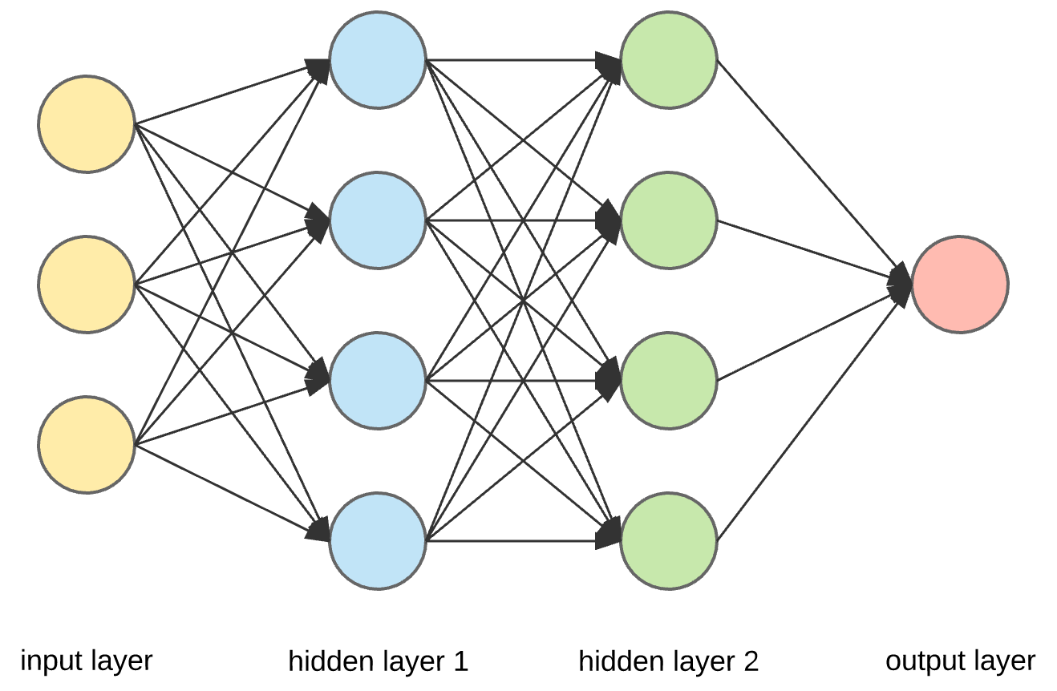
Block Diagram for ANN

Slide 13
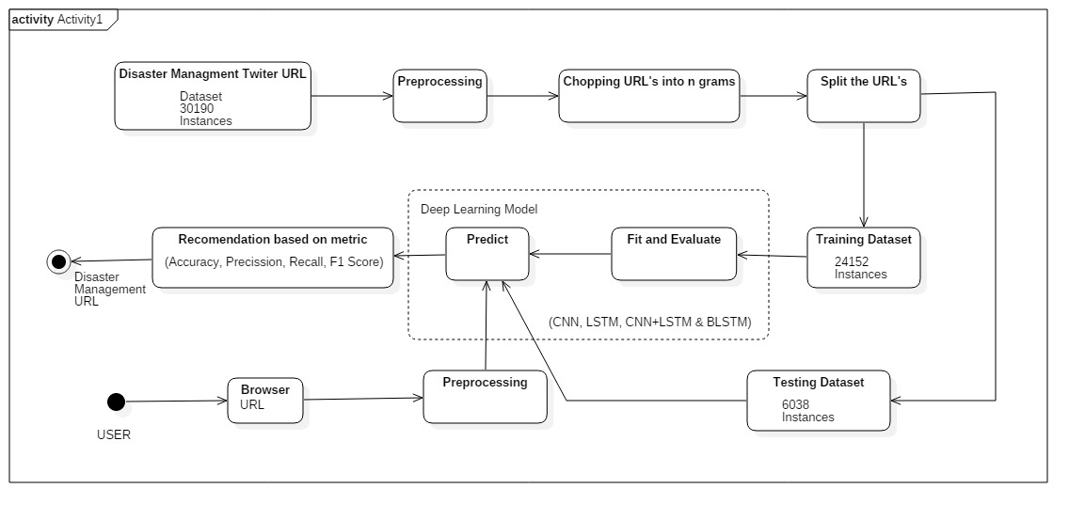
BLOCK DIAGRAM

Slide 14
LSTM
Long short-term memory (LSTM) is an artificial Recurrent Neural Network (RNN) architecture used in the field of deep learning. Unlike standard feedforward neural networks, LSTM has feedback connections. It can not only process single data points (such as images), but also entire sequences of data (such as speech or video). For example, LSTM is applicable to tasks such as unsegmented, connected handwriting recognition], speech recognition and anomaly detection in network traffic or IDS's (intrusion detection systems).
A common LSTM unit is composed of a cell, an input gate, an output gate and a forget gate. The cell remembers values over arbitrary time intervals and the three gates regulate the flow of information into and out of the cell.

Slide 15
ANN(ARTIFICIAL NUERAL NETWORK)
A neural network is a method in artificial intelligence that teaches computers to process data in a way that is inspired by the human brain. It is a type of machine learning process, called deep learning, that uses interconnected nodes or neurons in a layered structure that resembles the human brain.
Neural networks can help computers make intelligent decisions with limited human assistance. This is because they can learn and model the relationships between input and output data that are nonlinear and complex. For instance, they can do the following tasks

Slide 16
Evaluation metrics
Classification Accuracy : The proportion of the total number of predictions that were correct.
F1 Score : F1-Score is the harmonic mean of precision and recall values for a classification problem.
Recall : The proportion of actual positive cases which are correctly identified.
Precision : The proportion of positive cases that were correctly identified

Slide 17
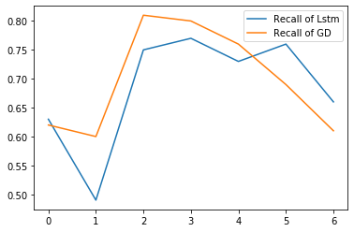
LSTM Results

Slide 18
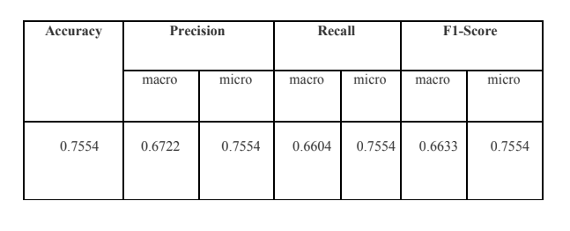
LSTM Results

Slide 19
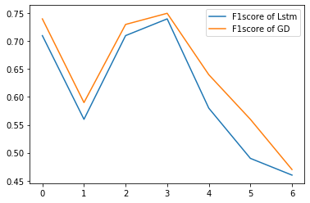
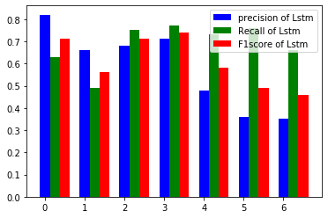
LSTM Results

Slide 20
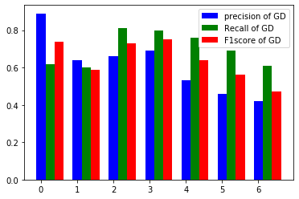
LSTM Results

Slide 21
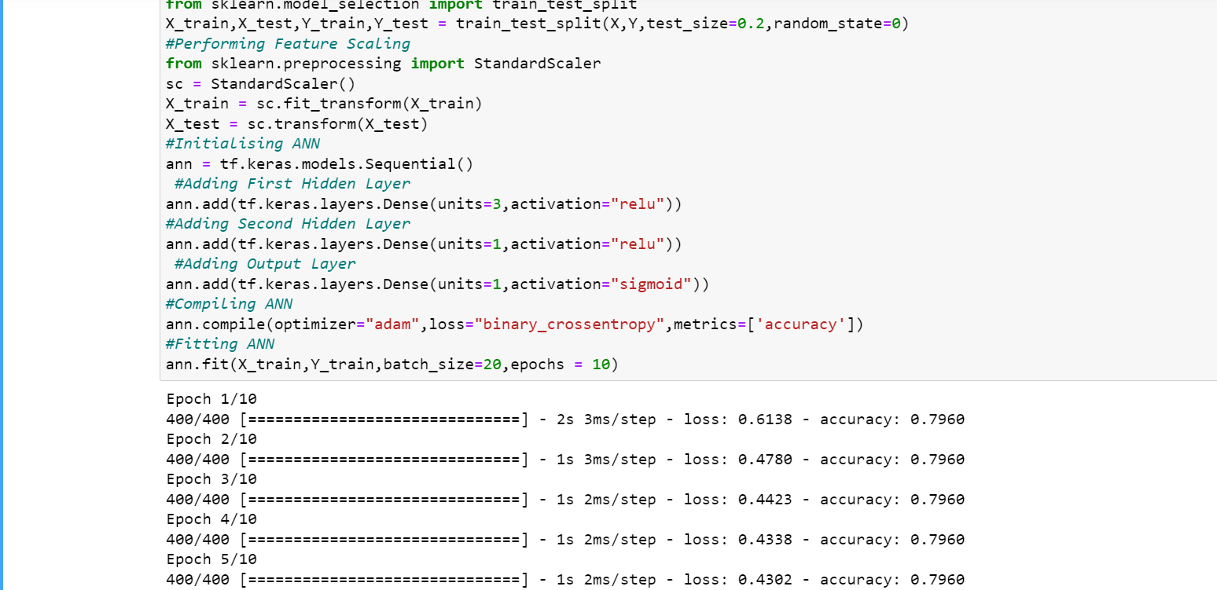
ANN RESULTS

Slide 22
References
Alexandra Olteanu, Sarah Vieweg, and Carlos Castillo. “What to Expect When the Unexpected Happens: Social Media Communications Across Crises Human Factors; Measurement”. In: (). DOI: 10.1145/ 2675133.2675242. URL: http://dx.doi.org/10.1145/2675133.2675242.
Alexandra Olteanu et al. “CrisisLex : A Lexicon for Collecting and Filtering Microblogged Communi- cations in Crises”. In: the Eighth International AAAI Conference on Weblogs and Social Media. 2014, pp. 376–385.
Jeffrey Pennington, Richard Socher, and Christopher Manning. “Glove: Global Vectors for Word Rep- resentation”. In: Proceedings of the 2014 Conference on Empirical
Methodsin NaturalLanguageProcessing(EMNLP).2014.ISBN: 9781937284961. DOI: 10.3115/v1/D14-1162.
Bernd Resch, Florian Usländer, and Clemens Havas. “Combining machine-learning topic models and spatiotemporal analysis of social media data for disaster footprint and damage assessment”. In: Cartogra- phy and Geographic Information Science 45.4 url : http://www.tandfonline.com/action/journalInformation?journalCode= tcag20.
Christian Reuter and Marc-Andre Kaufhold. “Fifteen years of social media in emergencies: A retro- spective review and future directions for crisis Informatics”. In: Journal of Contingencies and Cri- sis Management 26.1 (Mar. 2018), pp. 41–57. DOI: 10.1111/1468- 5973.12196. URL: http: //doi.wiley.com/10.1111/1468-5973.12196.
Stefan Stieglitz et al. “Sense-making in social media during extreme events”. In: Journal of Contingencies and Crisis Management 26.1 (Mar. 2018), pp. 4–15. ISSN: 14685973.
DOI:10.1111/1468-5973.12193.URL:http://doi.wiley.com/10.1111/1468- 5973.12193.
Kevin Stowe et al. “Improving Classification of Twitter Behavior During Hurricane Events”. In: the 6th International Workshop on Natural Language Processing for Social Media.Melbourne, Australia, 2018, pp. 67–75. URL: http://aclweb.org/anthology/W183512.
Jacob Devlin et al. “ANN: Pre-training of Deep Bidirectional Transformers for Language Understanding”. 2018

Slide 23


